Slide 1
Observations on the State of the IT Function at the University of California Tom Andriola Chief Information Officer Vice President
Presentation to Committee on Compliance and Audit
March 19-20, 2014 Regents Meeting

Slide 2
Data Gathering/Campus Listening Tour
Data Gathering
Visits to all campuses , medical centers, institutes, and LBNL
Meetings with faculty & administrators
Presented at various leadership meetings
Review of CIO material from industry sources; UC and peer CIO interviews
Review of available budgets and Spend Analytics
Observations
UC fundamentally has good IT teams in place
All locations struggle with demand overload, talent retention & aging infrastructure
No mechanism for prioritization between systemwide & local initiatives
Good examples of local innovation; rarely leveraged beyond a single situation
Security practices at UC Davis Health System
E-commerce application at UC Merced
Efficiency gains through IT at UC San Diego
Strengths in IT data center efficiency at LBNL

Slide 3
Further Observations
IT Leadership Council (ITLC) adopted a Collaboration Framework
Maintains local autonomy, goal setting & decision making
Explores opportunities to collaborate for common solutions
Implies “Coalition of the willing” “Where it makes sense”
Framework not systematic and does not build long-term strategic value
Framework lacks certain fundamentals
Strategic plan, roadmap, principles or standards
Incentive or reward system for collaborating
Funding model to facilitate collaboration
Data shows local decisions create proliferation in technologies & vendor choices
Duplication & proliferation leads to increased complexity & overall system costs
Difficult to exchange information (interoperability)

Slide 4
Current Actions & Direction
Strengthen & accelerate action on Collaboration Framework
Completing an enterprise application inventory
Need to balance local & systemwide criteria for IT investment decisions
Align to P200 Procurement initiative
Created IT Purchasing Center of Excellence
Addressing lack of discipline, e.g., off-contract buying & vendor proliferation
Starting to leverage UC size & spend to our benefit
Take portfolio management approach to better categorize costs and investments
Lower costs for IT utility services using industry blueprints
Shift percentage of IT investment toward advancing the mission
Develop a stronger sense of IT community, encouraging the sharing of best practices
Adopt a systemwide talent development and retention approach

Slide 5
Information Technology & Telecom – Spend Data
Information Technology and Telecom have total annual addressable spend $412M
Top-20 contributing ~50% of the total annual addressable spend
IT suppliers represent 18% of total suppliers used by UC
Key Facts
Annual Addressable Spend by Suppliers
Total (Tracked) Spend for FY13 | $417M
Annual (Tracked) Addressable Spend | $412M
Suppliers | 7,280
Suppliers for top 80% spend | 159
Supplier Name | Spend | % of Spend | System-wide agreement
Dell Inc | $26.85 M | 6.51% | Y
IBM Corp | $26.24 M | 6.37% | Y
Apple Inc | $20.75 M | 5.03% | Y
Oracle Corp | $18.94 M | 4.59% | Y
Cisco Systems | $14.26 M | 3.46% | Y
Hewlett-Packard Co | $10.32 M | 2.50% | Y
SHI International Corp | $9.52 M | 2.31% | Y
CDW Direct Llc | $9.46 M | 2.29% | N
Office Max | $8.44 M | 2.05% | Y
Starting Line | $8.03 M | 1.95% | N
KST Data Inc | $6.98 M | 1.69% | N
Xerox Corp | $6.39 M | 1.55% | Y
Point & Click Solutions Inc | $5.37 M | 1.30% | N
The Emmes Corp | $5.23 M | 1.27% | N
Blackbaud Co | $4.91 M | 1.19% | N
Sciquest Inc | $4.41 M | 1.07% | Y
Signal Perfection Limited | $4.28 M | 1.04% | Y
Bear Data Systems Inc | $4.14 M | 1.00% | N
Comsys IT Svcs Inc | $4.06 M | 0.99% | N
Nexus Integration Svcs Inc | $3.53 M | 0.86% | N
Others | $210.11M | 50.97%
Total | $412.23M
Annual Addressable Spend by Campus
No. of suppliers
1,125
151
3,127
1,363
982
1,809
1,015
659
571
662
237

Slide 6
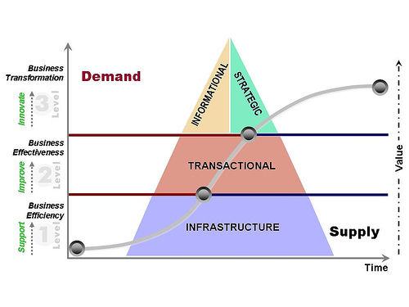
Common Framework for IT Investments
Domain & Business led innovation
Online Ed
Flipped Classes
Carbon Neutrality
PPP
Reporting (DW)
Data Dashboards
Analytics/Visualization
Technology led innovation
Social / Mobile platforms
Next-gen networks
Big data analytics
Cloud Computing
Invest
High Impact Processes
Student
Learning Mgmt.
Research
Low Impact Processes
FIN - GL, AR, AP
HR, Payroll, et al.
Invest
Costs
Email Storage
Data centers Servers
Network Telecom
End-user devices
Costs

