Slide 1
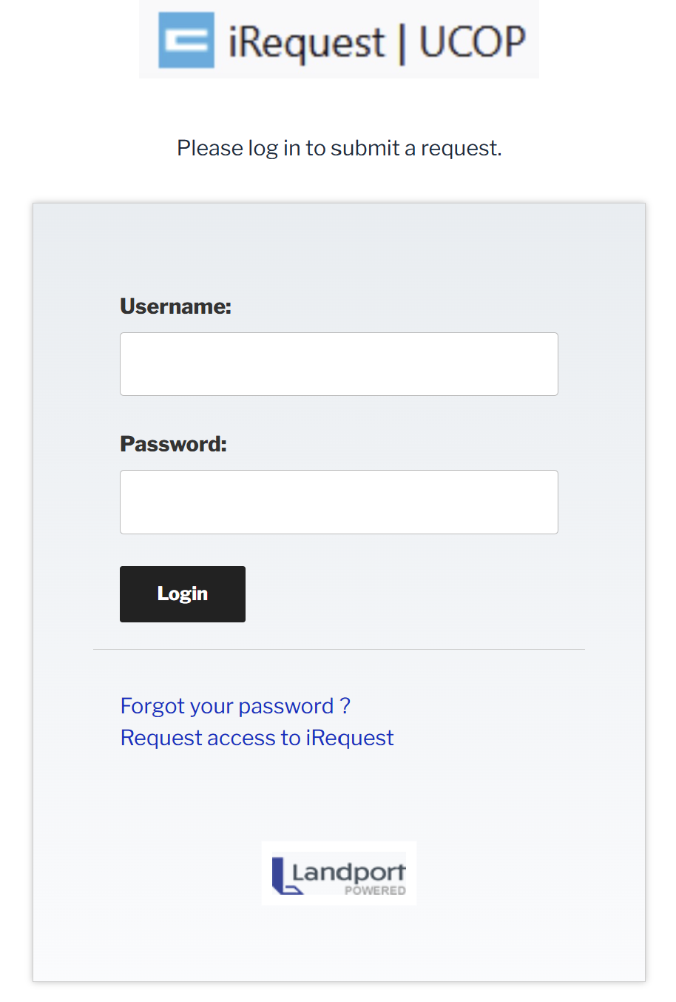
Logging In/Out of iRequest
Enter Username. (Often your email address)
Enter Password. (Use Forgot your password? to reset if needed)
Tap Login.
To logout, tap Log Out on the menu bar.
To request a new account, tap Request access to iRequest and complete the form.
For further help, please contact BuildingServices@ucop.edu.

Slide 2
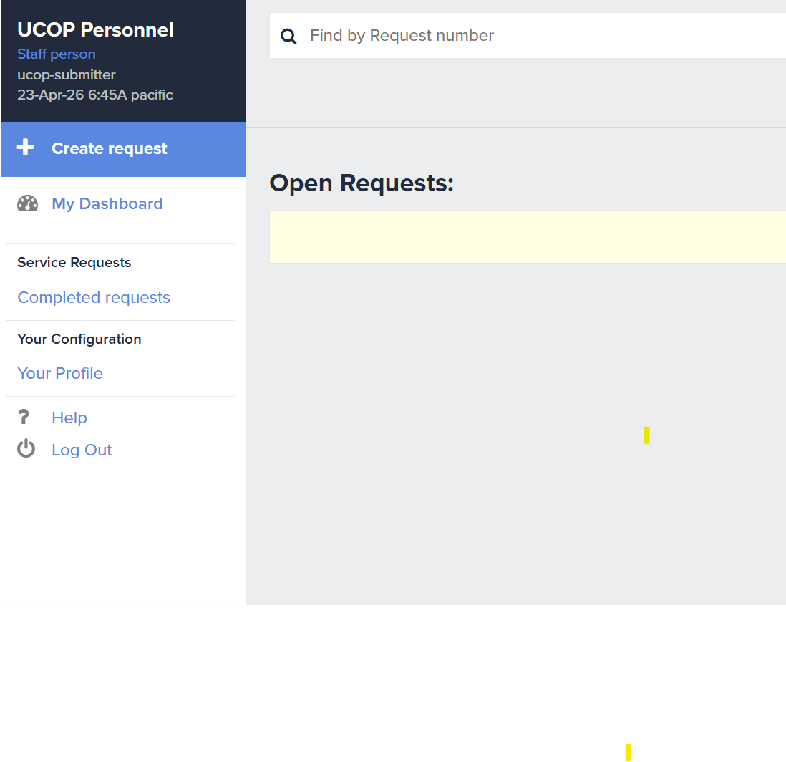
Creating A New iRequest
Tap Create request.

Slide 3
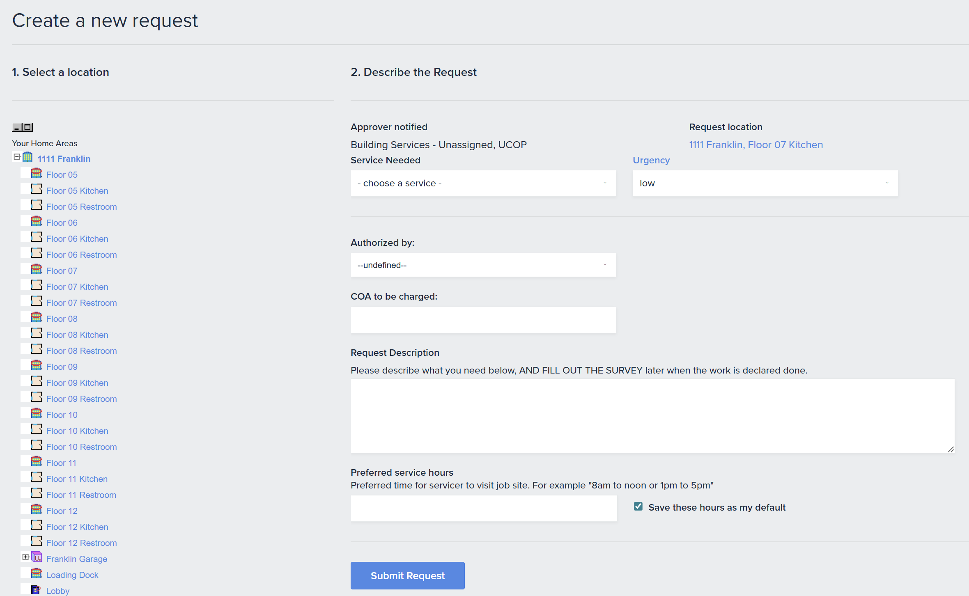
Creating A New iRequest (continued)
Select location. (Expand/contract the list by tapping the “+/-”)
Select Service Needed.
Adjust Urgency.
Enter Authorizer & COA, i.e. if a cost is associated with the request.
Enter Request Description.
Tap Submit Request.
Return to the Dashboard by tapping My Dashboard.

Slide 4
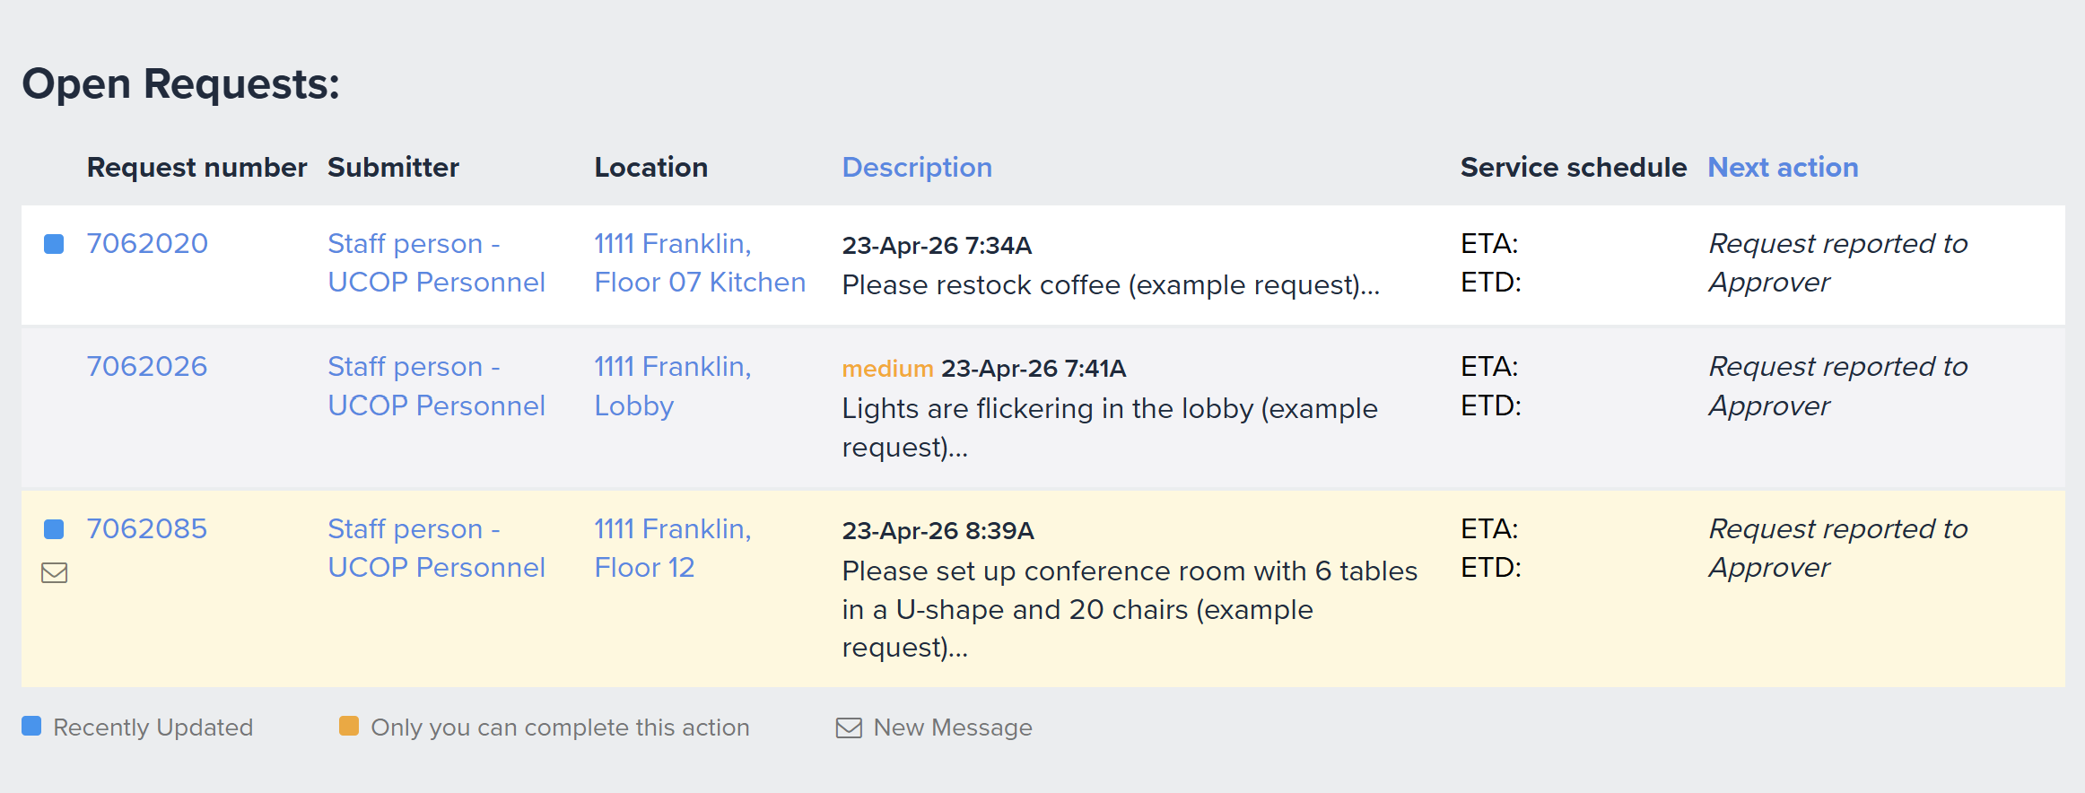

Reviewing & Adding Comments to Existing iRequests
Any Request number with a new comment will have the following symbol next to it:
To view the comment, tap the Request number (i.e. 7062085).
Note: The last request on which you took an action will be highlighted in cream.

Slide 5
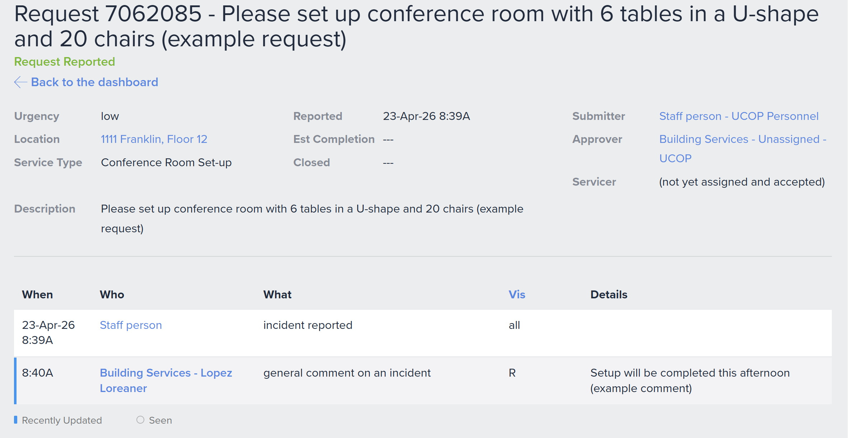
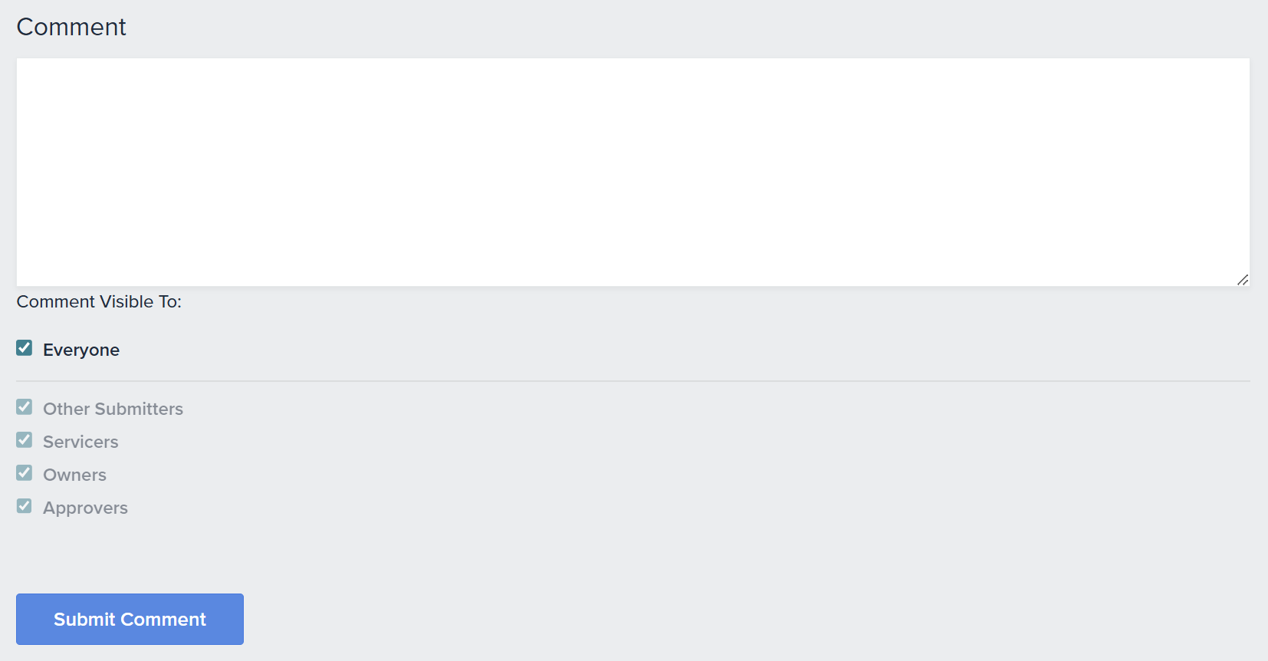
Reviewing & Adding Comments to Existing iRequests (continued)
Review date and time-stamped comments (new ones are bolded and have a leading, blue edge).
To enter your own comment:
Scroll to Comment field at bottom of page.
Enter new comment.
Leave comment visibility as-is.
Tap Submit Comment.
Notes:
2 comment boxes on submitter account? Will be corrected with new screenshot

Slide 6
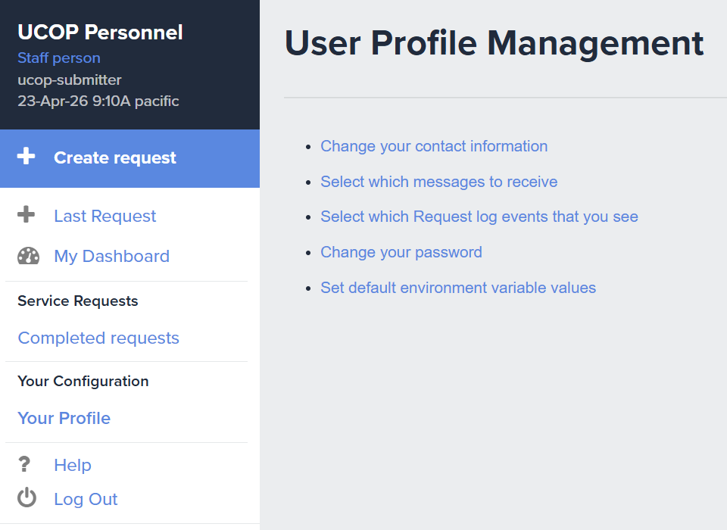
Changing Your Password
Tap Your Profile.
Tap Change your password.
On the following page, you’ll be prompted to submit a new password.

