Slide 1
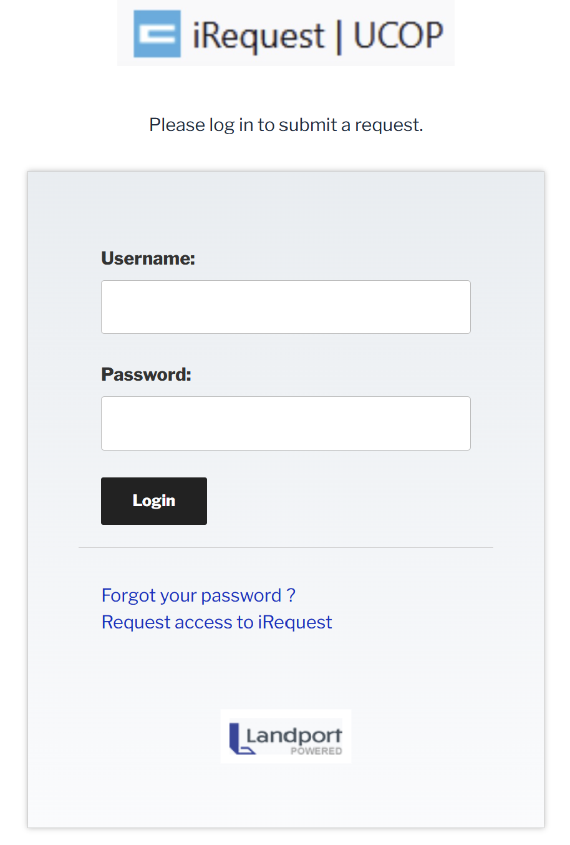
Logging In/Out of iRequest
Enter Username.
Enter Password. (Use Forgot your password? to reset if needed)
Tap Login.
To logout, tap Log Out on the menu bar.
To request a new account, tap Request access to iRequest and complete the form.
For further help, please contact BuildingServices@ucop.edu

Slide 2
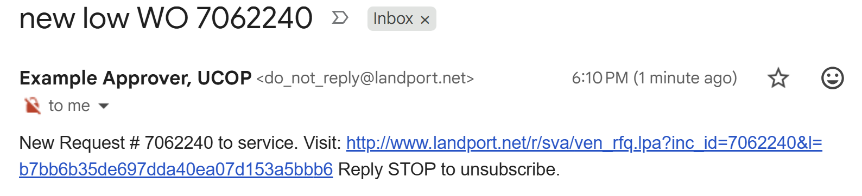
Responding to a New iRequest
When UCOP Building Services dispatches an iRequest to you, a notification email (or text) is generated:
To review the request, tap the link contained in the notification.
A new browser window will open. You’ll automatically be logged into your iRequest account and taken directly to the particular iRequest.
Notes:
Include tapping the email/text link and going to review page?

Slide 3
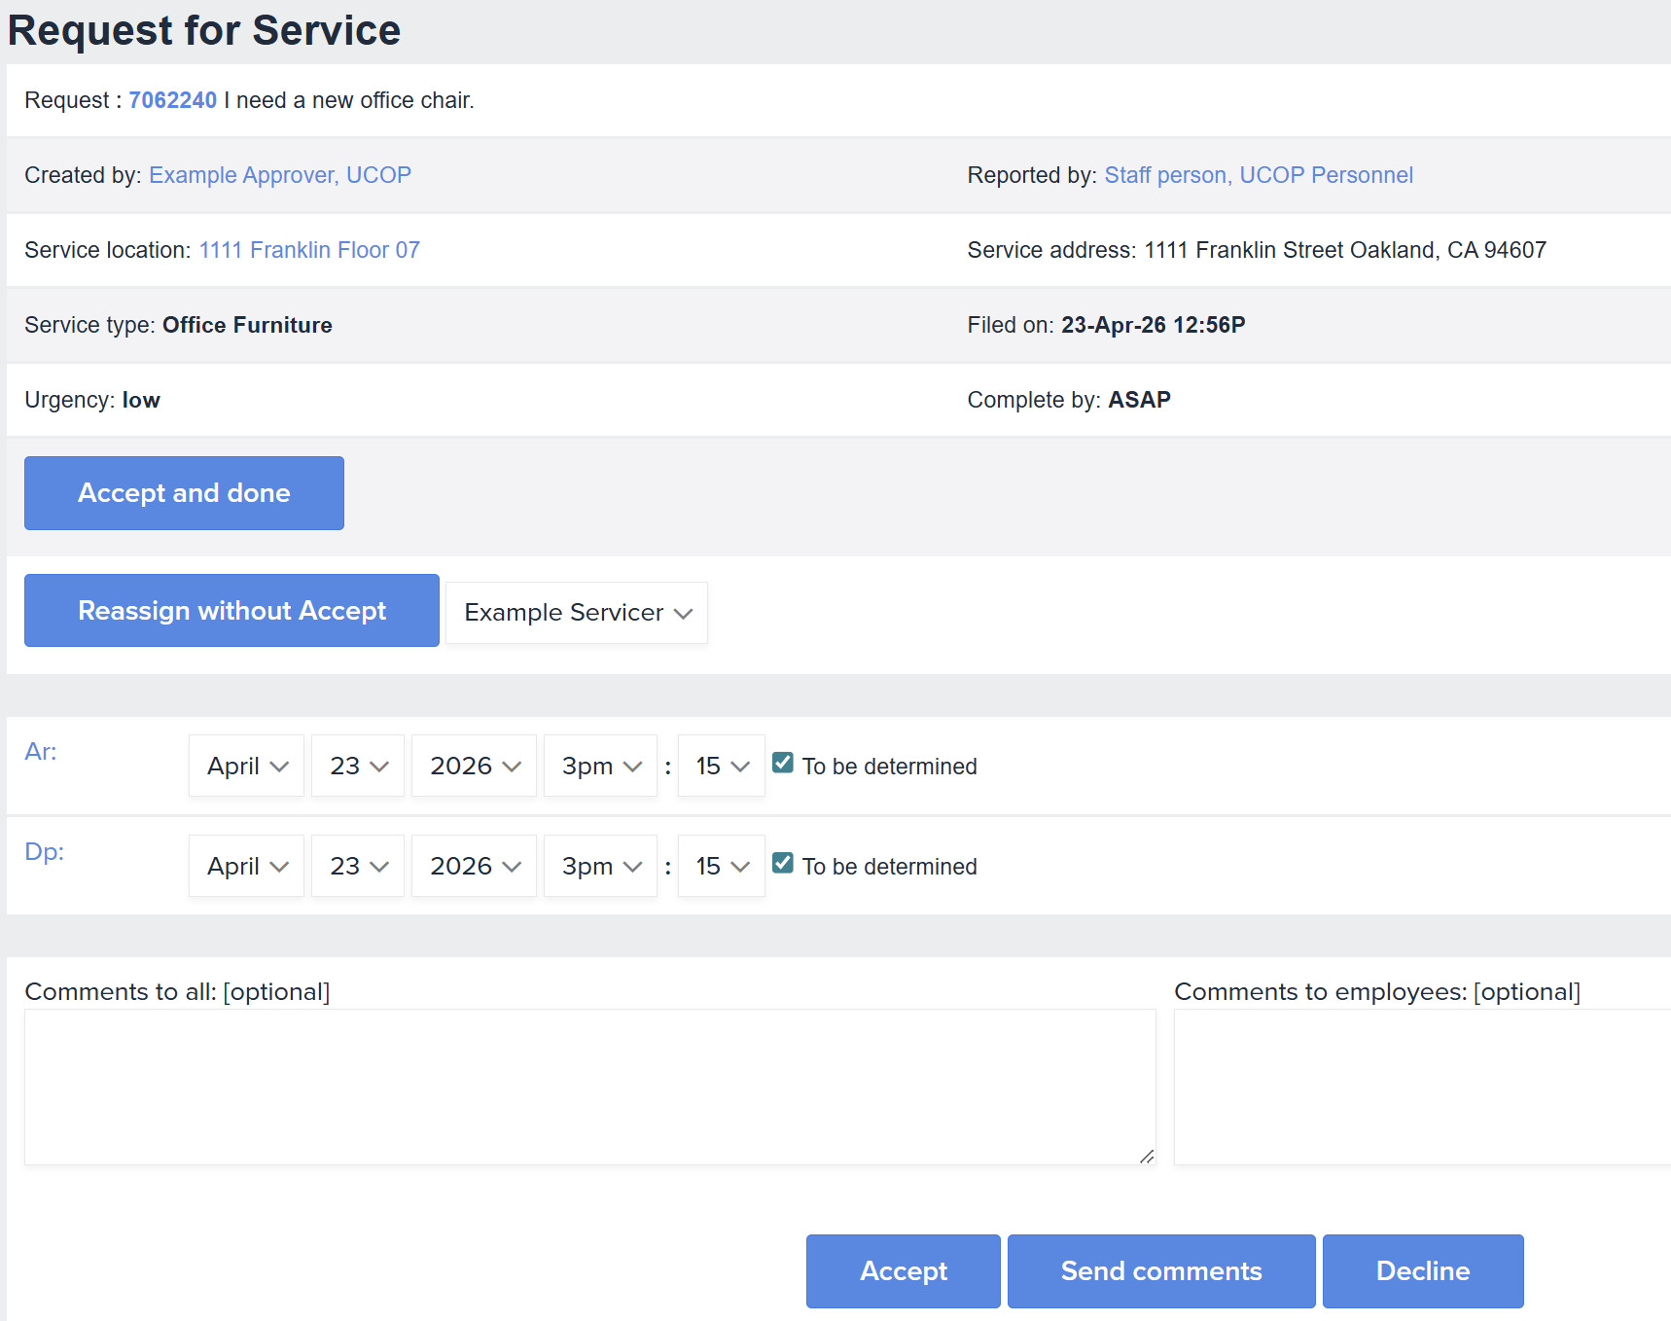
Reviewing a New iRequest
Review the Request description, tapping the request number (i.e. 7062240) if the full description is not visible.
Note other necessary details, such as Reported by, Service location/address, and Urgency.
Bypass Accept and done and Reassign without Accept, unless instructed otherwise.
Specify time of Arrival and/or Departure (optional).
Enter Comments to UCOP Building Services Manager and original requester (optional).
Tap Accept (You may also Decline or only Send comments).
Tap My Dashboard to return to main page.

Slide 4
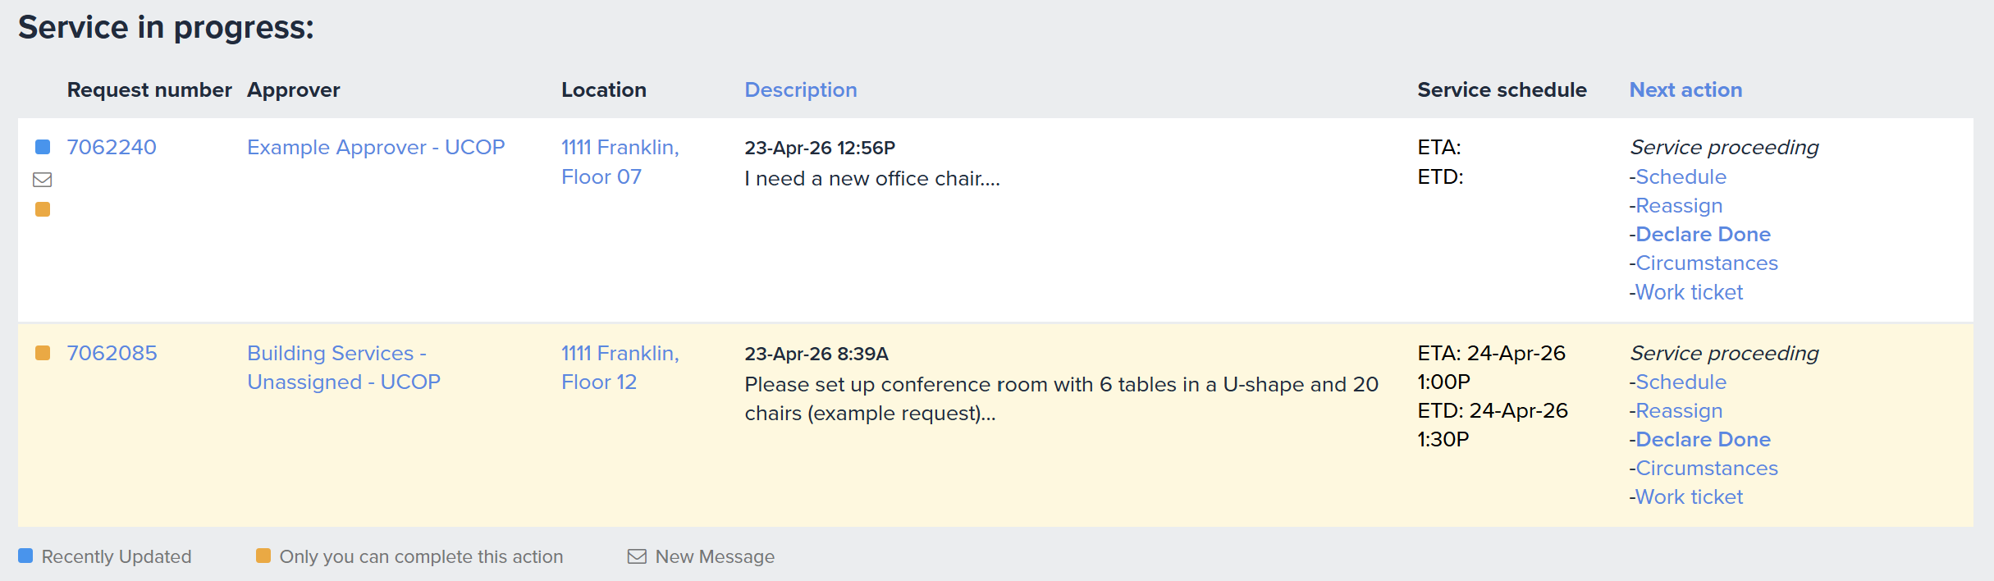

Reviewing & Adding Comments to Existing iRequests
Any Request number with a new comment will have the following symbol next to it:
To view the comment, tap the Request number (i.e. 7062240).
Note: The last request on which you took an action will be highlighted in cream.

Slide 5
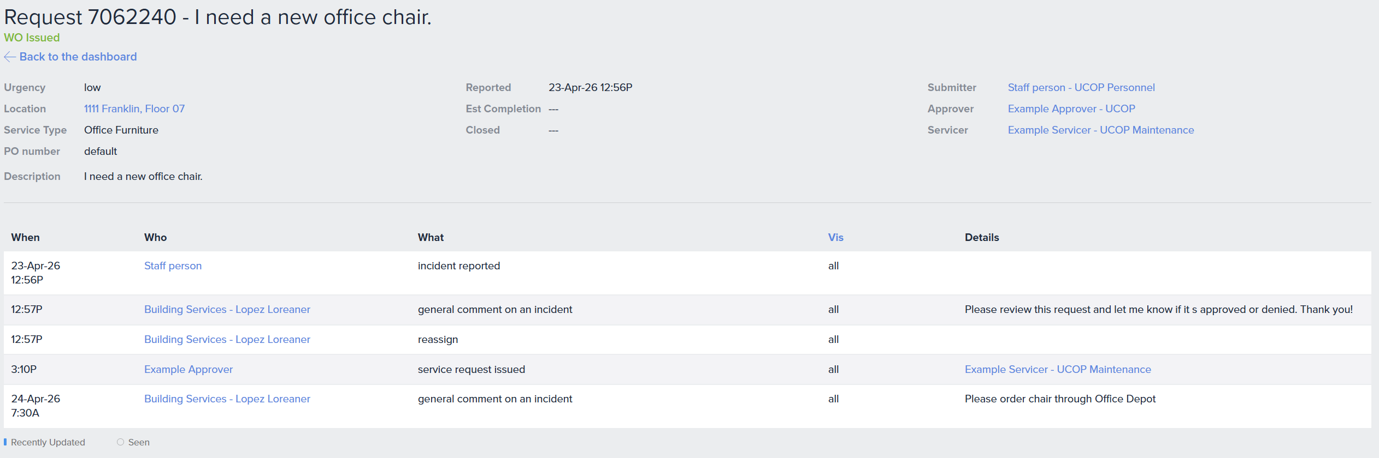
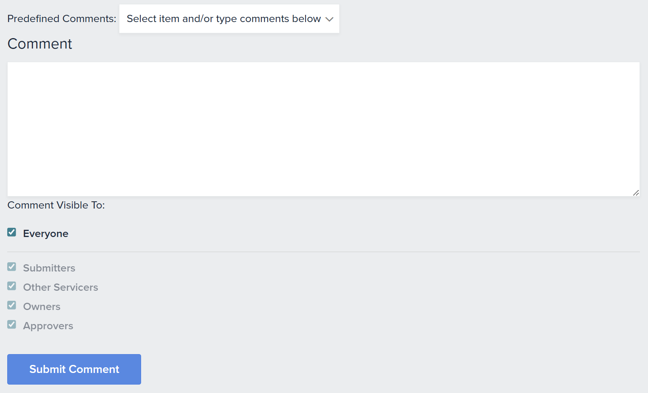
Reviewing & Adding Comments to Existing iRequests (continued)
Review date and time-stamped comments (new ones are bolded and have a leading, blue edge).
To enter your own comment:
Scroll to Comment field at bottom of page.
Enter new comment. (You may opt to use the Predefined Comments dropdown)
Tap Submit Comment.

Slide 6
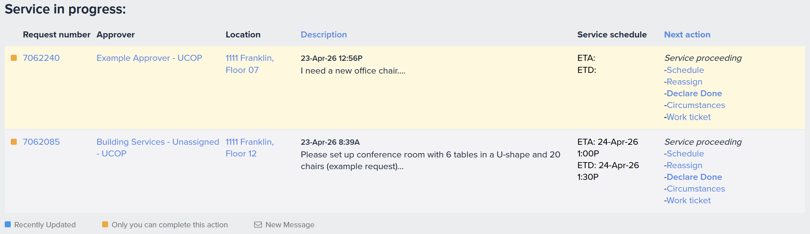
Declaring Completion
When the work is completed, tap Declare Done.

Slide 7
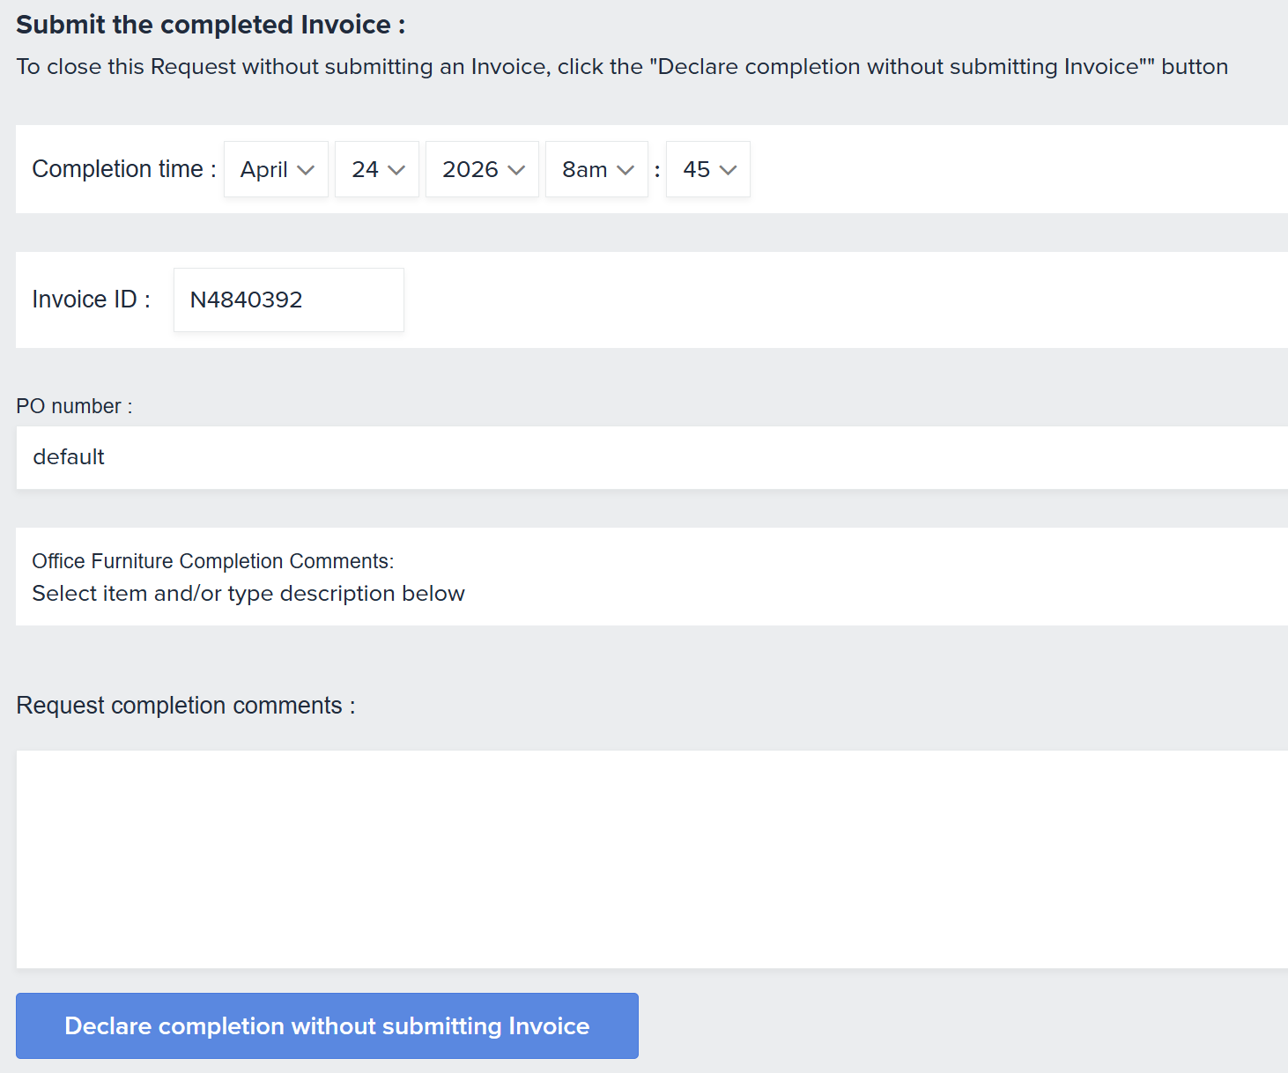
Declaring Completion (continued)
Scroll down to the bottom of the next page.
Adjust the Completion time, if needed.
Enter Request completion comments, using the optional dropdown.
Tap Declare completion without submitting Invoice.
Note: You will not be entering invoices.

Slide 8
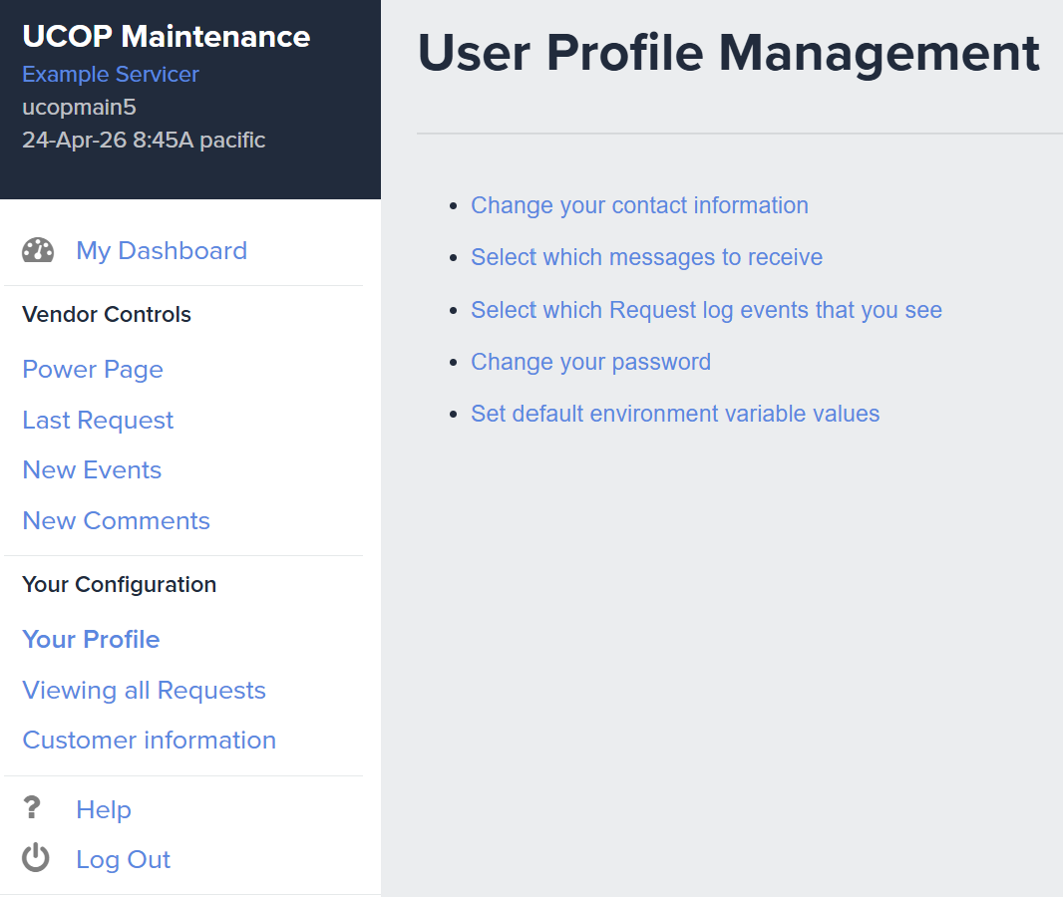
Changing Your Password
Tap Your Profile.
Tap Change your password.
On the following page, you’ll be prompted to submit a new password.

