Slide 1
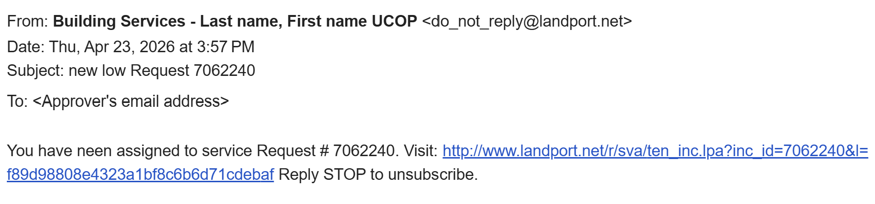

Responding to Email Notification of New iRequest
When an iRequest needs to be reviewed for approval, Building Services reassigns it to the designated approver responsible for the assigned COA. This reassign step generates a notification email to the approver:
To approve (or deny) the request, tap the link contained in the email message:
A new browser window will open. You’ll automatically be logged into your iRequest account and taken directly to the particular iRequest.

Slide 2
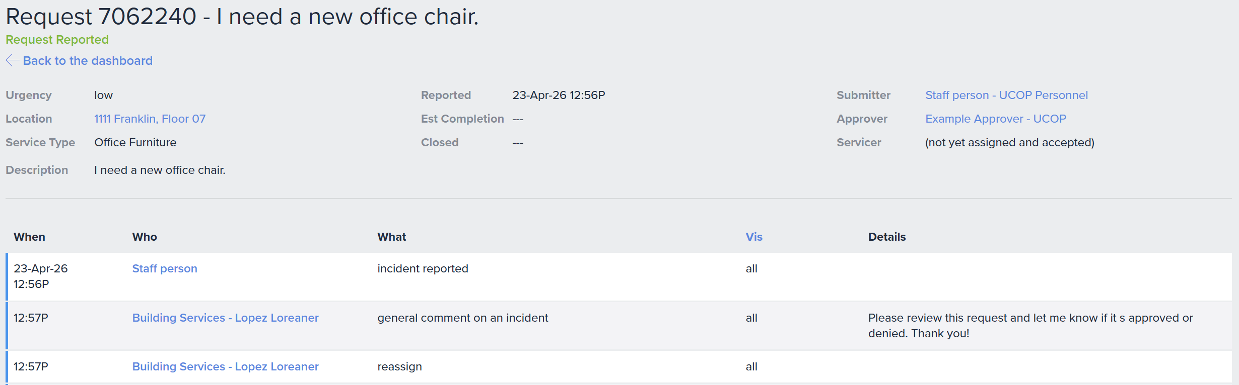
Reviewing iRequest
Review the Location, Description, Submitter, and comment from Building Services, noting who entered it (in this case Loreaner Lopez).

Slide 3
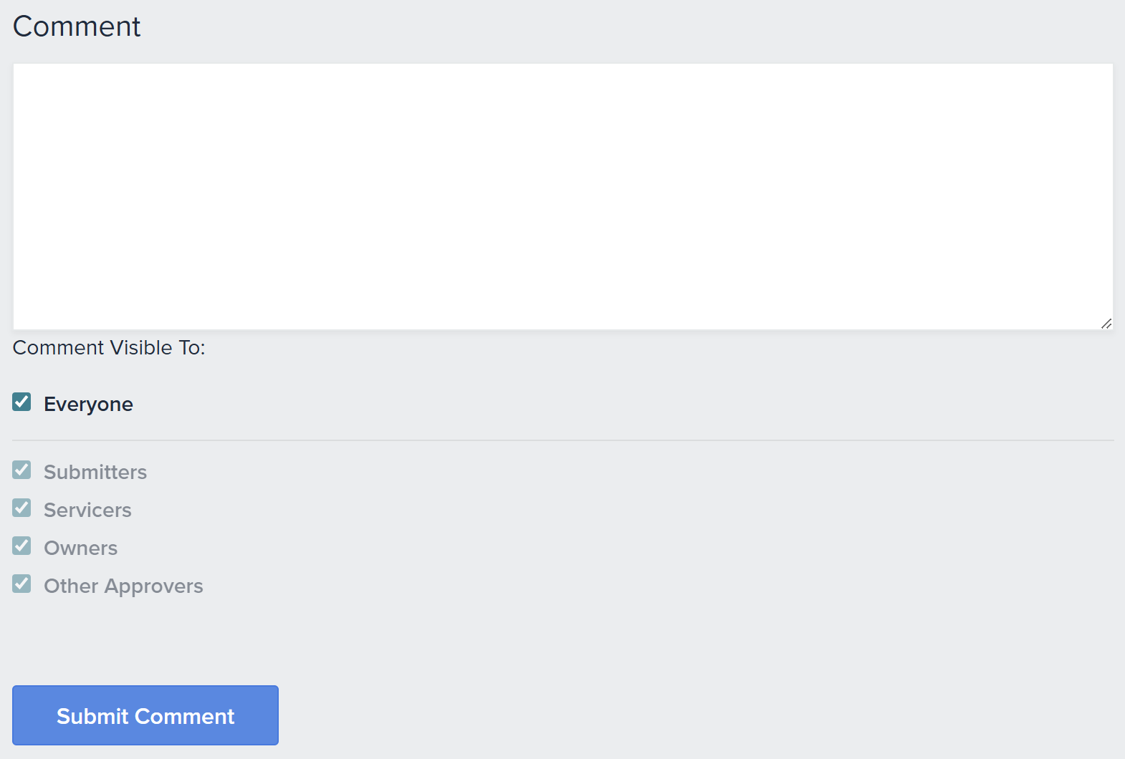
Communicating Approval/Denial to Building Services
Scroll down to the Comment section.
Enter an approved or denied comment.
Tap Submit Comment.
Note: Building Services will automatically be notified.

