Slide 1
Biological Hazards
West Nile Virus
Hantavirus
Lyme Disease
Safety Meeting August 2010
Developed by Karen Hsi, UCOP EH&S Student Intern
Notes:
This month’s safety topic is Biological Hazards. You might ask, what exactly is does biological hazards mean and what does it have to do with me, especially at work. Biological hazards refers to biological substances that pose a threat to the health of living organisms, primarily that of humans. It is very possible to come across these hazards in the workplace, whether that be in the storage or attic at the office, on campus visits, or just during personal outdoor activities and events. In this safety presentation, we will be discussing three biological hazards: West Nile Virus, Hantavirus, and Lyme Disease. We will go through what they are, how they are transmitted and the steps you can take to prevent them.

Slide 2
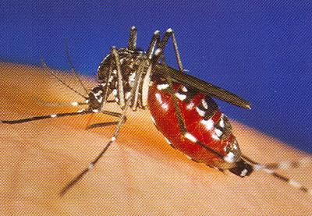
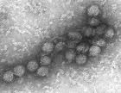
West Nile Virus
Notes:
The high months for mosquito activity for San Francisco and the Bay Area are coming up in September and October, so this is the perfect time to discuss West Nile Virus and how you can prevent it. Whether you are out on a campus visit or just enjoying summer activities outdoor at your own leisure, here are some tips to help you enjoy the warm weather safely.

Slide 3
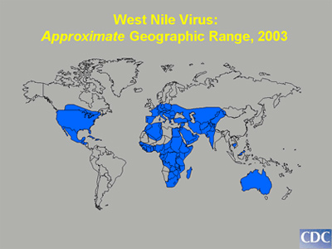
What is West Nile Virus?
Flavivirus genus
Commonly found in Africa, Eastern Europe, West Asia and the Middle East
In North America only during the last couple of years
Mosquito high
months:
September and
October for SF/Bay Area
Notes:
West Nile Virus is a microorganism belonging to the Flavivirus genus. It is commonly found in humans, birds and other animals in Africa, Eastern Europe, West Asia and the Middle East. During the last couple of years its prevalence has been discovered in North America.

Slide 4
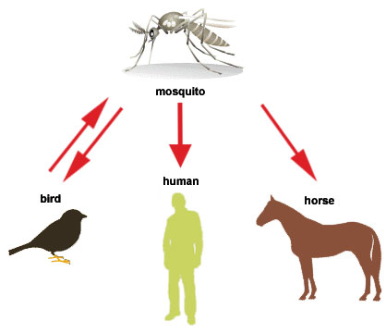
Transmission of West Nile Virus
Spread to Humans By Bites From Infected Mosquitoes
Mosquitoes Infected When They Feed on Infected Birds
No Evidence of Transmission in Humans By Person-to-Person Contact
Can Spread Via:
Needle Sticks or Blood Transfusions
Notes:
West Nile Virus is spread to humans by bites from infected mosquitoes. These mosquitoes are infected when they feed on infected birds
There is no Evidence of Transmission in Humans By Person-to-Person Contact
Can Spread Via :Needle Sticks or Blood Transfusions

Slide 5
Prevention of West Nile
Draining sources of standing water where they lay eggs
Roof gutters, tires, pools, etc.
Protect yourself from mosquito bites
Apply insect repellent to skin and clothing
Wear long-sleeves and long pants if weather permits
Consider staying indoors during peak mosquito biting times (Dawn, Dusk, and Early Evenings)
Install or repair window and door screens
Notes:
Here are some ways to help prevent catching West Nile virus. First, you can help reduce the number of mosquitoes in areas outdoors, by draining sources of standing water where they lay eggs. For example, roof gutters, tires, and pools all could accumulate a storage of water, just be aware and cautious of mosquitoes around those areas of your house. Next, protect yourself from mosquito bites by applying insect repellent to skin and clothing, wearing long-sleeves and long pants if weather permits, staying indoors during peak mosquito biting times (dawn, dusk, and early evenings), or installing or repairing window and door screens to prevent mosquitoes from getting indoors.

Slide 6
Prevention Informational Video
http://www.youtube.com/watch?v=qGz6tHNNAEo

Slide 7
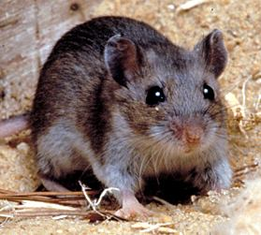
Hantavirus Pulmonary Syndrome (HPS)
Notes:
Storage or attic areas are places we all have to enter whether we want to or not. Places like these are known to house rats, mice, and other small critters whose droppings, urine, and saliva are the carriers of Hantavirus Pulmonary Syndrome (HPS). Here is some information to help you be aware of this biological hazard next time you are cleaning out the office storage or the attic of your house!

Slide 8
What is HPS?
Spread by infected rodents and can be potentially deadly to humans
First recognized in 1993 and has been identified throughout the U.S.
Also known as the “House Mouse Flu”
Notes:
Hantavirus pulmonary syndrome (HPS) mostly spread by infected rodents and can be potentially deadly to humans. It was first recognized in 1993 and has been identified throughout the U.S. Hantavirus is also commonly known as the “House Mouse Flu”.

Slide 9
Transmission of HPS
Transmitted through urine, droppings, or saliva of infected rodents
Disease can be contracted when breathing in aerosolized virus.
Hosts: deer mouse, cotton rat, marsh rice rat, white-footed mouse, and etc.
Notes:
HPS is often transmitted through urine, droppings, or saliva of infected rodents. Humans can contract the disease when they breathe in aerosolized virus. Typically the hosts are deer mouse, cotton rat, marsh rice rat, white-footed mouse, and etc.

Slide 10
Prevention of HPS
Be cautious in storage areas and attics/basements
Eliminate or minimize contact with rodents in your home, workplace, and campsite
Seal up holes and gaps
Place traps around the house
Clean up easy-to-get-to food
Notes:
To prevent hantavirus, you should eliminate or minimize contact with rodents in your home, workplace, and campsite. You can do this by sealing up holes and gaps, placing traps around the house, and cleaning up easy-to-get-to food.

Slide 11
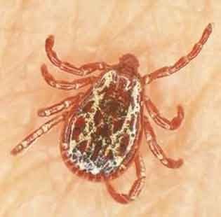
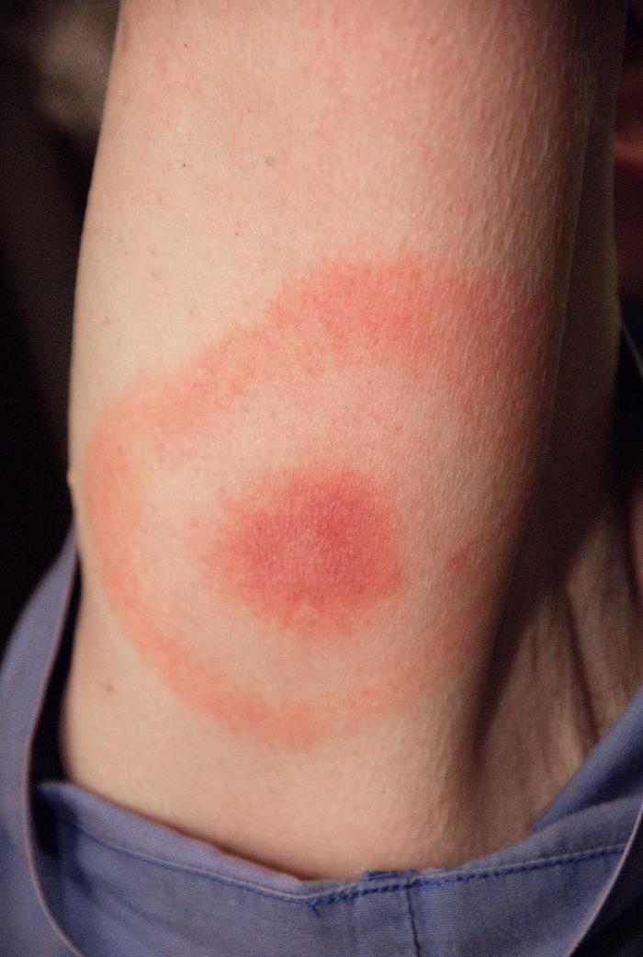
Lyme Disease
Notes:
For those who visit campuses, you might enter some bushy and grassy areas. Or for personal or office-related affairs, such as hiking, camping, or going on picnics be careful of ticks that transmit Lyme disease. Although the bite of a tick might not seem dangerous, Lyme disease if not treated could potentially be deadly.

Slide 12
What is Lyme Disease?
Most common tick-borne illness in the Northern Hemisphere
Most active May, June, and July
Spread through the bite of an infected tick
Early Symptoms: fever, headache, depression, circular skin rash (erythema migrans)
Notes:
Lyme disease is the most common tick-borne illness in the Northern Hemisphere. The ticks that transmit lyme disease are most active during the months of May, June, and July. It is spread through the bite of an infected tick.
The early symptoms include: fever, headache, depression, circular skin rash (erythema migrans).

Slide 13
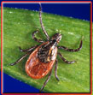
Transmission of Lyme Disease
Can often go undetected
Normally lives in mice, squirrels, and other small animals
Passed onto humans through the bites of certain species of ticks.
In U.S. by Black-legged ticks
Be cautious of ticks when going
outdoors and in grassy areas!
Notes:
The disease normally lives in mice, squirrels, and other small animals. It is
passed onto humans through the bites of certain species of ticks. In the U.S. it is usually transmitted by Black-legged ticks.

Slide 14
Prevention of Lyme Disease
Protect yourself from tick bites
Control ticks around your home and immediate environment
Manage deer populations and movement because they are the main source of blood for adult ticks to reproduce
Clothing: long sleeve/pants, socks/shoes
Inspect clothes and pets after going outdoors
Consult your doctor after tick bites
Treated with antibiotics
Learn the early signs of tick-borne illnesses
Notes:
To prevent Lyme disease, you can protect yourself from tick bites by controlling ticks around your home and immediate environment. If you live near hills, you can help to manage deer populations and movement helps because deer are the main source of blood for adult ticks to reproduce. You can also simply remember to wear long sleeves and pants and the appropriate socks and shoes when going into grassy areas. Makes sure that when you return from your outdoor activities, you inspect your clothes and pets for ticks that may have come home with you. You should also consult your doctor after tick bites, because they can be treated early with antibiotics. By learning the early signs of tick-borne illnesses, you can treat Lyme disease earlier and avoid more serious complications.

